Slide 1
Ch 6 Rational Functions
Lesson 1
Simplifying Rational Expressions and NPV’s
© Copyright all rights reserved to Homework depot: www.BCMath.ca

Slide 2
What are Rational Expressions?
A rational expression is a fraction where both the numerator and denominator are polynomials
In this section, the numerator and dominator are binomials and trinomials that can be factored, making it easier to simplify
“x” can’t be an exponent or inside a radical, exponents of ‘x’ must be a integer [not fractions]
The numerator is a trinomial
Top/Bottom are
both trinomials
The denominator
is a binomial
Both top/bottom can be factored
Both top/bottom can be factored
Binomials can be simplified if you have one at the top and one at the bottom

Slide 3
Are these Rational Expressions:
Ex: Indicate whether if the following expressions are rational expressions?

Slide 4
I) Simplifying Rational Expressions
You can only simplify fractions when you have a common factor in both the numerator & denominator
Common
Factor:
No Common
Factors
When Simplifying binomials, factor out the common factor first, then simplify
Factor
in the
numerator
Factor:
in the numerator

Slide 5
Simplify Each of the following:

Slide 6
III) Simplifying R.E. with Binomials
You can only cancel out a binomial only when it’s a common factor in both the Numerator & Denominator
Can’t cancel, b/c the
binomials are not the
same
When there’s a trinomial or a difference of squares in the expression, factor them first
Then cancel out any common factors or binomials in both the top & bottom
Factor the expression
Cancel out any
common factors

Slide 7

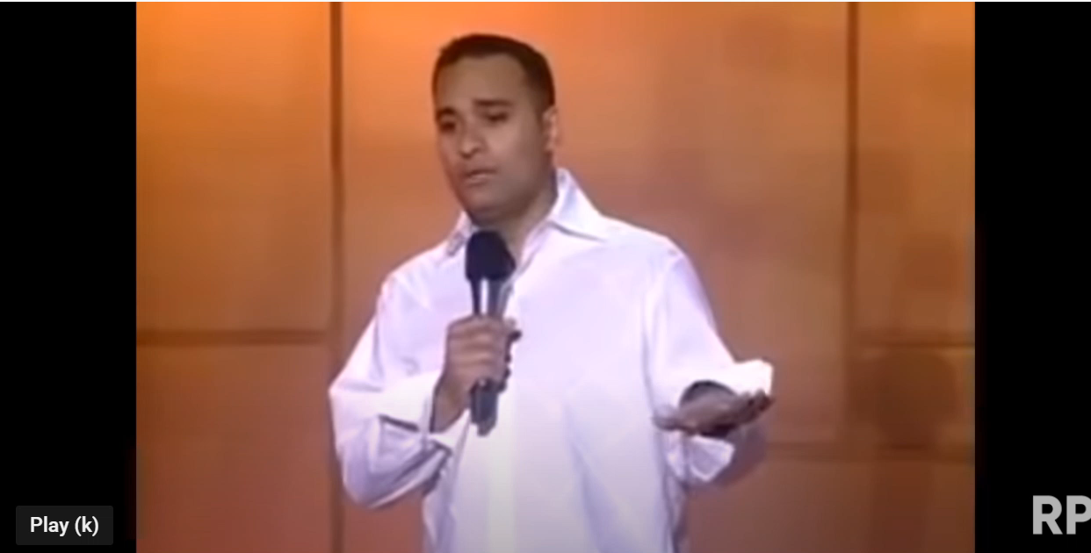
Common BIG MISTAKES!!!
YOU can not cancel a common term from the top and bottom if it is added or subtracted!
NOOO!! nNoo….noo….
NOOO!!
Same reason, can’t cancel the x’s like this
ALSO NO!!!!
You can’t cancel the “x’s” because they are added to another term on top and bottom
3 minutes of people saying “NO” in movies……

Slide 8
Practice: Factor and Simplify
Factor the expression
Cancel out any
common factors

Slide 9
V) Non-Permissible Values (NPV)
Permissible → Allowed, Non Permissible → Not Allowed
When evaluating rational expressions, the denominator is not allowed to be Zero
Can’t divide by zero → Undefined!!
Any value of “x” (variable) that makes the denominator equal to zero is called a NPV
When finding the Non-Permissible Values
  Take the entire denominator
  Make it equal to zero
  Then solve for “x” (variable)
  Factor the denominator
  These are values that “x” can not be (Not Permissible!)
© Copyright all rights reserved to Homework depot: www.BCMath.ca

Slide 10
Ex: Find the NPV for each Expression
For which value(s) of the variable is each expression undefined
Denominator
Factor
Equal to zero
Solve for “x”
“x” can NOT be 1/3,
otherwise the expression
will be undefined
© Copyright all rights reserved to Homework depot: www.BCMath.ca

Slide 11
Practice: Find the NPV
Factor
Factor
© Copyright all rights reserved to Homework depot: www.BCMath.ca

Slide 12
Simplify each expression and Find the NPV
Denominator
NPV:
Can’t square root a neg. number

